Slide 1
Advanced Web programming
Lec-13
Unit 3
Error Handling, Logging, and Tracing

Slide 2
Error handling in ASP.NET has three aspects:
Tracing - tracing the program execution at page level or application level.
Error handling - handling standard errors or custom errors at page level or application level.
Debugging - stepping through the program, setting break points to analyze the code
Error Handling
add error handling settings in the web.config file of the application. It is application-wide error handling.
The <customErrors> section has the possible attributes:
Mode : It enables or disables custom error pages. It has the three possible values:
On : displays the custom pages.
Off : displays ASP.NET error pages (yellow pages)
remoteOnly : It displays custom errors to client, display ASP.NET errors locally.
defaultRedirect : It contains the URL of the page to be displayed in case of unhandled errors.

Slide 3
Error Handling
The goal of error handling (also known as exception handling) is quite simple: to prevent exceptions or errors thrown during the execution of an application request from reaching users.
Ideally, users should not know that an exception occurred, or they should at least be provided with an informative message that tells them what they can do to resolve the problem.
ASP.NET provides three techniques for achieving this goal:
Custom error pages
Page_Error and Application_Error events
Structured exception handling

Slide 4
a. Custom error pages
Allow you to assign one or more error pages to be displayed when an exception occurs.
b. Page_Error and Application_Error events
Writing event handlers for either or both of these events allows you to catch and handle exceptions at the page or application level.
c. Structured exception handling
New to Visual Basic .NET, and also available in C#, this type of exception handling allows exceptions to be caught and handled in particular blocks of code.
These three techniques provide broadest (custom error pages, which can handle exceptions from any page in the application) to narrowest (structured exception handling, which handles exceptions for a specific block of code) coverage for handling application exceptions.

Slide 5
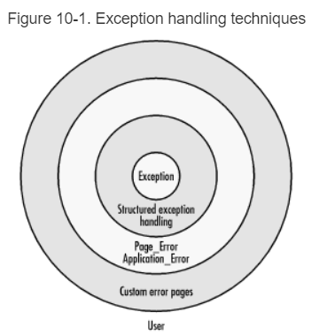

Slide 6
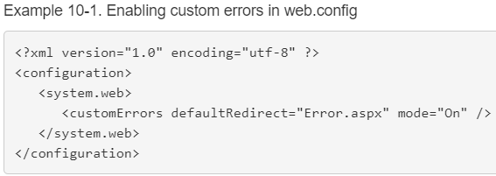
a. Custom Error Pages
The simplest, technique for handling exceptions in ASP.NET applications is to implement one or more custom error pages.
You can do this by creating a web page to display an error message to the user.
Then you specify that page as the default error page (or to handle a specific class of error) in web.config, using the <customError> configuration element.
Example 10-1 shows a web.config file that defines a default custom error page called Error.aspx.

Slide 7
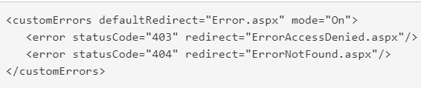
In addition to providing a default error page, the <customErrors> element also supports the use of child <error> elements to specify custom error pages for specific classes of errors, such as authentication (HTTP 403) or Not Found (HTTP 404) errors, as shown in the following code snippet:
Any errors for which there is not a specific <error> element defined are handled by the page specified by the defaultRedirect attribute.

Slide 8
B. Page_Error and Application_Error
Another technique for error handling that provides the ability to handle a broad range of application errors is the use of the Error event defined by the Page and HttpApplication classes.
Unless AutoEventWireup has been set to False (the default in Web Forms pages created with Visual Studio .NET), ASP.NET automatically calls page or application-level handlers with the name Page_Error or Application_Error if an unhandled exception occurs at the page or application level, respectively.
The handler for Page_Error should be defined at the page level.
C. Structured Exception Handling
In structured exception handling, you wrap code that may throw an exception in a Try...Catch block
The Try statement (lowercase try in C#) warns the runtime that the code contained within the Try block may cause an exception; the Catch statement (catch in C#) provides code to handle the exception.

Slide 9
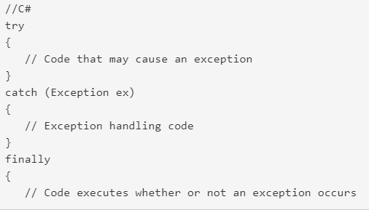
Structured Exception Handling

Slide 10
Exceptions are problems encountered in program at run time.
C# supports exception handling.
When an exception occurs in code notification is sent, and exception handling code are
specified to handle exception in rational manner.
General Structure of Exception Handling Mechanism :
try
{
// Risky code goes here (opening a file, connecting to a database, and so on).
}
catch
{

Slide 11
// An error has been detected. You can deal with it here.
}
finally
{
// Time to clean up, regardless of whether or not there was an error.
}
To handle exception C# uses following keywords.
(i) try :
It contains block of code that needs to be monitored for occurrence of exception.
If exception occurs within try block there is a chance of it being handled.
try block can be followed by either catch or finally or both.

Slide 12
(ii) catch :
It contains exception handling code.
(iii) throw :
used to throw exception manually.
Mainly used for throwing user defined exception.
(iv) finally :
Contains code that needs to be executed irrespective.
Exception is generated or not.
Generated exception is handled or not.

Slide 13
Creating and Throwing Exceptions
Exceptions are used to indicate that an error has occurred while running the program. Exception objects that describe an error are created and then thrown with the throw keyword.
The runtime then searches for the most compatible exception handler.
Programmers should throw exceptions when one or more of the following conditions are true:
1. The method cannot complete its defined functionality.
For example, if a parameter to a method has an invalid value:
static void CopyObject(SampleClass original)
{
if (original == null)
{
throw new System.ArgumentException("Parameter cannot be null", "original");
}
}

Slide 14
2. An inappropriate call to an object is made, based on the object state.
One example might be trying to write to a read-only file.
In cases where an object state does not allow an operation, throw an instance of InvalidOperationException or an object based on a derivation of this class.
3. When an argument to a method causes an exception.
In this case, the original exception should be caught and an ArgumentException instance should be created.
The original exception should be passed to the constructor of the ArgumentException as the InnerException parameter:

Slide 15
static int GetValueFromArray(int[] array, int index)
{
try
{
return array[index];
}
catch (System.IndexOutOfRangeException ex)
{
System.ArgumentException argEx = new System.ArgumentException("Index is out of range", "index", ex);
throw argEx;
}
}

Slide 16
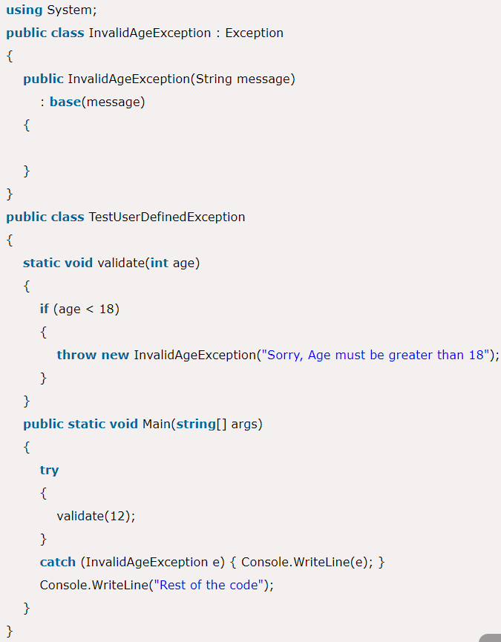
C# User-Defined Exceptions
C# allows us to create user-defined or custom exception. It is used to make the meaningful exception. To do this, we need to inherit Exception class.

Slide 17
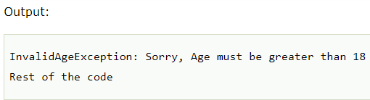
User-Defined Exception

Slide 18
ASP.NET tracing enables you to view diagnostic information about a single request for an ASP.NET page. ASP.NET tracing enables you to follow a page's execution path, display diagnostic information at run time, and debug your application.
There are two ways:
(i) Page Level Tracing
(ii) Application Level Tracing
(i) Page Level Tracing
We can control whether tracing is enabled or disabled for individual pages.
If tracing is enabled, when the page is requested, ASP.NET appends to the page a series of tables containing execution details about the page request.
Tracing is disabled by default in an ASP.NET application.

Slide 19
Explain Page Tracing in ASP.NET
Enabling Tracing: To use tracing, we need to explicitly enable it. There are several ways to enable tracing. One of the easiest ways is by adding an attribute to the Page directive in the .aspx file: <%@ Page Trace="true" ... %> We can also enable tracing using the built-in Trace object. Here's an example of how to turn on tracing in the Page. Load event handler: using System.Web; protected void Page_Load(Object sender, EventArgs e) { Trace.IsEnabled = true; // (Trace is an instance of the System.Web.TraceContext class) } By default, once the tracing is enabled, it will apply only to local requests. This limitation prevents end users from seeing the tracing information. If we need to trace a web page from a remote location, we have to enable remote tracing by changing some settings in the web.config file.

Slide 20

To enable Page Level Tracing follow the steps:
Include Trace="true" in <%@ Page Title="" Language="C#"...%> directive, for example:
<%@ Page Title="" Language="C#" MasterPageFile="~/MasterPage.master" AutoEventWireup="true" CodeFile="Default.aspx.cs"Inherits="chat_Default" Trace="true"%>
Using Trace=true at the end.
In the above code, using Trace=true at the end.
ii) Optionally, we can use TraceMode attribute in above <%@ Page Title="" Language="C#"...%> directive, for example:

Slide 21
SortByTime: Set TraceMode to SortByTime to sort trace messages in the order in which they are processed.
SortByCategory: Set TraceMode to SortByCategory to sort trace messages by the categories.
iii) Now press F5 to run the application, you will see the immediate trace record on an existing page that you have set Trace and TraceMode.
Application Level Tracing
Instead of enabling tracing for individual pages, you can enable it for your entire application.
In that case, every page in your application displays trace information. Application tracing is useful when you are developing an application because you can easily enable it and disable it without editing individual pages. When your application is complete, you can turn off tracing for all pages at once.
When you enable tracing for an application, ASP.NET collects trace information for each request to the application, up to the maximum number of requests you specify. The default number of requests is 10. You can view trace information with the trace viewer.
By default, when the trace viewer reaches its request limit, the application stops storing trace requests. However, you can configure application-level tracing to always store the most recent tracing data, discarding the oldest data when the maximum number of requests is reached.

Slide 22
To enable Application Level Tracing follow the steps:
i) Delete your Page Level Tracking for better result.
ii) Open the Web.config file and add the following information to it; if there is not a Web.config file available then add a new one in the root.
trace.axd
It is a viewer which has some features for displaying trace information for us.
To add this file to the application simply navigate to add new file and name it trace.axd; it will automatically add the required code for the viewer.

Slide 23
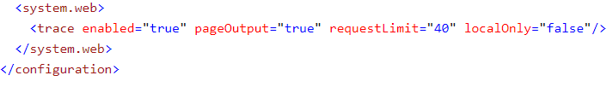
iii) The above code has many attributes used, find the detailed information about them below.
Enabled: Set it true to enable tracing for the application; otherwise, false. The default is false. You can override this setting for individual pages by setting the Trace attribute in the @ Page directive of a page to true or false
PageOutput: Set it true to display trace both in pages and in the trace viewer (trace.axd); otherwise, false. The default is false.
RequestLimit: The number of trace requests to store on the server. The default is 10.
LocalOnly: Set it true to make the trace viewer (trace.axd) available only on the host Web server; otherwise, false. The default is true.

Slide 24
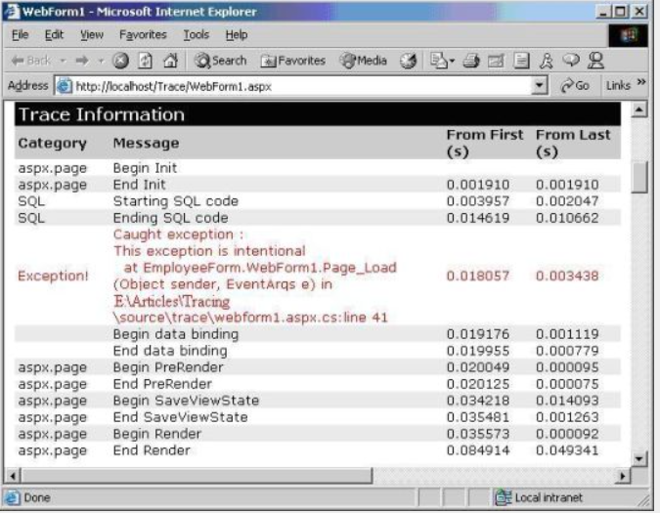
Page tracing

Slide 25
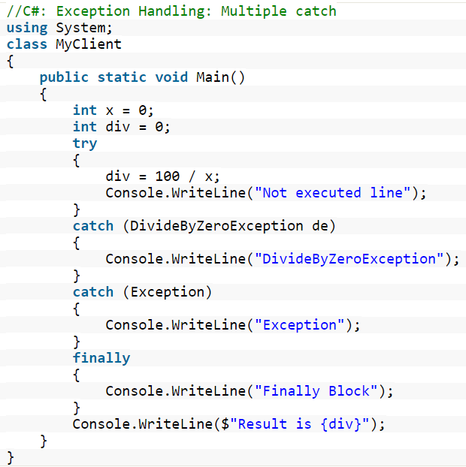
Multiple Catch Blocks
A try block can throw multiple exceptions, which can handle by using multiple catch blocks.
More specialized catch block should come before a generalized one, Otherwise the compiler will show a compilation error.

Slide 26
The main purpose of the catch block is to handle the exception raised in the try block. This block is only going to execute when the exception raised in the program.
In C#, You can use more than one catch block with the try block.
Generally, multiple catch block is used to handle different types of exceptions means each catch block is used to handle different type of exception.
If you use multiple catch blocks for the same type of exception, then it will give you a compile-time error because C# does not allow you to use multiple catch block for the same type of exception.
A catch block is always preceded by the try block.
In general, the catch block is checked within the order in which they have occurred in the program.
If the given type of exception is matched with the first catch block, then first catch block executes and the remaining of the catch blocks are ignored.
And if the starting catch block is not suitable for the exception type, then compiler search for the next catch block.

Slide 27
Example 1: In the below example, try block generate two different types of exception i.e DivideByZeroException and IndexOutOfRangeException.
Now we use two catch blocks to handle these exceptions that are associated with a single try block.
Each catch block caught a different type of exception like catch block 1 is used to catch DivideByZeroException, catch block 2 is used to catch IndexOutOfRangeException.
program to illustrate the use of multiple catch block
using System;
class GFG {
// Main Method
static void Main()
{
// Here, number is greater than divisor
int[] number = { 8, 17, 24, 5, 25 };
int[] divisor = { 2, 0, 0, 5 };

Slide 28
// --------- try block ---------
for (int j = 0; j < number.Length; j++)
// Here this block raises two different
// types of exception, i.e. DivideByZeroException
// and IndexOutOfRangeException
try {
Console.WriteLine("Number: " + number[j]);
Console.WriteLine("Divisor: " + divisor[j]);
Console.WriteLine("Quotient: " + number[j] / divisor[j]);
}
// Catch block 1
// This Catch block is for
// handling DivideByZeroException
catch (DivideByZeroException) {
Console.WriteLine("Not possible to Divide by zero");
}

Slide 29
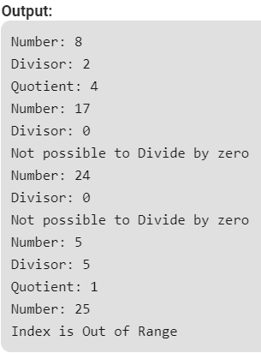
// Catch block 2
// This Catch block is for
// handling IndexOutOfRangeException
catch (IndexOutOfRangeException) {
Console.WriteLine("Index is Out of Range");
}

Slide 30
Example 2: In the below example, try block raise an exception. So we will use three different type of catch blocks to handle the exception raised by the try block. Catch block 1 will handle IndexOutOfRangeException, catch block 2 will handle FormatException, and catch block 3 will handle OverflowException.
// C# program to illustrate the concept
// of multiple catch clause
using System;
class GFG {
// Main method
static void Main()
{
// This block raises an exception
try {
byte data = byte.Parse("a");
Console.WriteLine(data);
}

Slide 31
// Catch block 1
// This block is used to handle
// IndexOutOfRangeException type exception
catch (IndexOutOfRangeException) {
Console.WriteLine("At least provide one Argument!");
}
// Catch block 2
// This block is used to handle
// FormatException type exception
catch (FormatException) {
Console.WriteLine("Entered value in not a number!");
}

Slide 32

// Catch block 3
// This block is used to handle
// OverflowException type exception
catch (OverflowException) {
Console.WriteLine("Data is out of Range!");
}
}
}

Slide 33
To be continued….

